Slide 1

WEASEL 2.0 - A Random Dilated Dictionary Transform for Fast, Accurate and Memory Constrained Time Series Classification
Patrick Schäfer, Ulf Leser
Speaker: Arik Ermshaus
Humboldt-University of Berlin, Germany
patrick.schaefer@hu-berlin.de
ECML PKDD 2023, Torino, September 18 -22 2023
Source Code

Slide 2
Time Series
Time series are ubiquitous!
Humans record data over time
Sensors data, Medical (ECG and EEG), Financial, Meteorological, Biological Processes, Motion Data and Video, Music

Slide 3

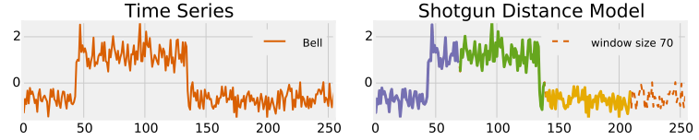

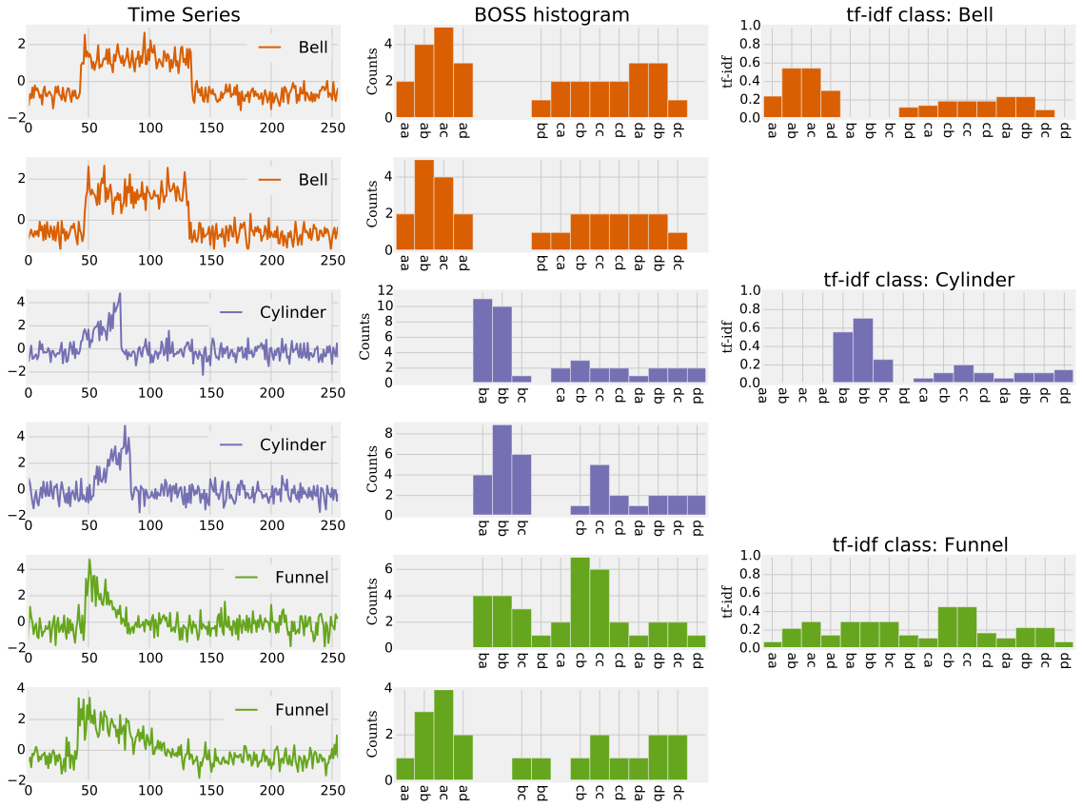
Time Series Classification (TSC)
Assign label to a time series using a model trained from labelled samples
Model (trained from labelled samples)
predict
y=Bell
train
labelled samples Y={Bell, Cylinder, Funnel}

Slide 4
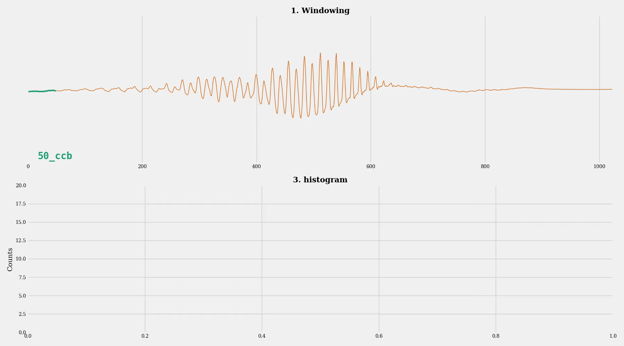
Background: Dictionary Models
Generates a vector of word counts as features
Distinguishes series by the frequency of occurrence of substructures, i.e. words
Words are generated using discretization (next slide)
Notes:
In the bag-of-patterns model, two TS are distinguished by the frequency of occurrence of substructures (words).
Feature are words or histogram over words.
So, how does this work:
First, we break up a TS into a bag of substructures of fixed lengths.
Words (and bigrams) are generated from these substructures using discretization.
And a histogram of feature counts is built and used as input to classification
Next we add words (and bigrams) for the next window length.
Feature space explodes and we have to apply some kind of feature selection.
Also we are mostly interested in those words that appear in just one class.

Slide 5
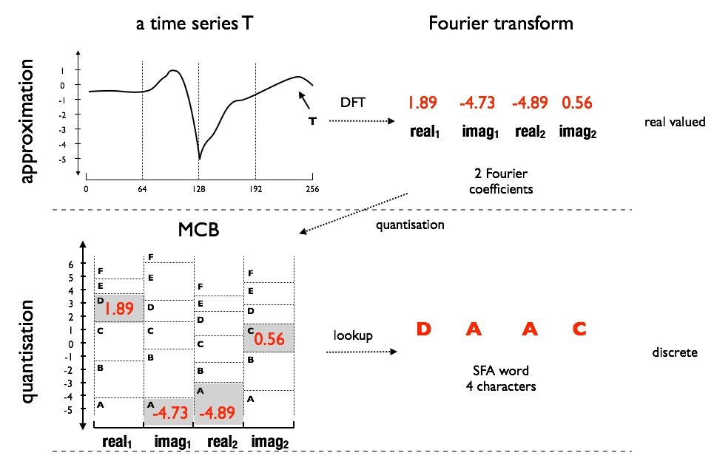


Background: Words from Subsequences
Transform a real-valued subsequence (window) into a sequence of symbols, over a finite alphabet
Two building blocks:
Approximation using Fourier Transform (for noise reduction)
Binning (equal-depth, equal-width) for obtaining symbols
Approximate using Fourier transform
Apply binning to each Fourier coefficient
Notes:
Unsupervised

Slide 6
Dictionary Model - Limitations
Have a huge memory-footprint (size of feature vector), due to a large variance in generated words
Dictionary methods have fallen behind SotA in accuracy
Up to millions of features = size of vector

Slide 7
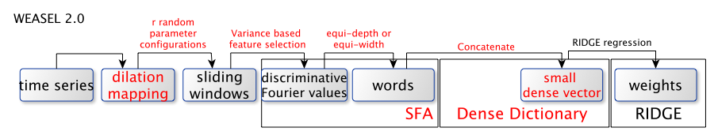
WEASEL 2.0 – Building Blocks
Apply dilation mapping prior to downstream processing
Emsembling randomized hyper-parameters
Notes:
Best Fourier coefficients are selected based on variance (unsupervised, no ANOVA statistical tests anymore (supervised))

Slide 8
Dilated Sliding Window
Dilation increases receptive field of a filter by inserting gaps
Process series at different scales, similar to down-sampling
But: keeps the total number of values in each window constant
First used in convolution-based approaches
Time Series T
0 | 1 | 3 | 2 | 9 | 1 | 14 | 15
Sliding window with dilation=2
Shifted along T
1st window
0 |  | 3 |  | 9
2nd window
1 |  | 2 |  | 1
3 |  | 9 |  | 14
3rd window
...
Example: d = 2 inserts gap of 1, down-samples by 2, doubles size of the receptive field

Slide 9
Dilation Mapping
A novel dilation mapping serves as a re-ordering transformation
Re-ordering can be applied as pre-processing step to the time series using 3 lines of python code
Re-ordering has the same effect as a dilated sliding window, but we do not need to alter any downstream codebase
def dilation(X, d): (1) X^{d} = X[:, 0::d] (2) for i in range(1, d): (3) X^{d} = np.concatenate((X^{d}, X[:, i::d]), axis=1)
X
X[:, 0::2]
X[:, 1::2]
Example for d=2

Slide 10
Dilation Mapping – Why it works
Time Series T
0 | 1 | 3 | 2 | 9 | 1 | 14 | 15 | 1 | 2 | 2 | 10 | 7
Reordered Time Series T
0 | 3 | 9 | 14 | 1 | 2 | 7 | 1 | 2 | 1 | 15 | 2 | 10
Sliding window with dilation=2
Shifted along T
Sliding window
Shifted along T
Starting at offset 0
0 |  | 3 |  | 9
0 | 3 | 9
3 |  | 9 |  | 14
3 | 9 | 14
9 |  | 14 |  | 1
9 | 14 | 1
14 |  | 1 |  | 2
14 | 1 | 2
1 |  | 2 |  | 7
1 | 2 | 7
We may filter these false positives
2 | 7 | 1
7 | 1 | 2
Starting at offset 1
1 |  | 2 |  | 1
1 | 2 | 1
2 |  | 1 |  | 15
2 | 1 | 15
1 |  | 15 |  | 2
1 | 15 | 2
15 |  | 2 |  | 10
15 | 2 | 10
Dilated Sliding Window on Raw Time Series is equal to Sliding Window on reordered Time Series

Slide 11
Ensemble randomized hyper-parameters
One fixed-size dense dictionary: Use only 128 to 256 distinct words in each dictionary by using word length w = [7,8] and alphabet size = 2
Ensemble over random hyper-parameters, yields ~70k features using
Train Ridge Regression classifier

Slide 12
Build an ensemble over random hyper-parameters
Choose from these
4 hyper-parameters
Dilation mapping applied to time series

Slide 13
Experiments
Compare WEASEL 2.0 to 15 SotA TSC methods on 114 UCR problems
Dictionary (D): BOSS, cBOSS, WEASEL, TDE;
Hybrid (H): HiveCote 2.0, HiveCote 1.0, TS CHIEF,
Deep-Learning (DL): InceptionTime;
Shapelets (S): R-DST, MrSQM SFA k5;
Kernel (K): Arsenal, MiniRocket, Multi- Rocket, Rocket, Hydra.
Used implementations available in aeon/sktime, or published by the authors (Dempster et al, 2023; Le Nguyen and Ifrim, 2022; Guillaume et al, 2022).
All reported numbers are accuracy on the test split (no resampling)
See recent bake-off redux [1] for results on resampling
[1] Middlehurst, Matthew, Patrick Schäfer, and Anthony Bagnall. "Bake off redux: a review and experimental evaluation of recent time series classification algorithms." arXiv preprint arXiv:2304.13029 (2023).

Slide 14
Rank against Dictionary Methods
WEASEL 2.0 is the most accurate dictionary-based method

Slide 15
Rank against SotA
It is not significantly worse than SotA in test accuracy
Most better methods are hybrids (ensembles of approaches)

Slide 16
Memory Footprint
WEASEL 2.0 has up to 70k features (constrained footprint)
This is comparable to Rocket et al.

Slide 17
Runtimes
WEASEL 2.0 is also fast in train and test times (runtimes measured using aeon/sktime toolkits)
Notes:
Ordered by Median time

Slide 18
Runtime
Fast and accurate
Low predict time, highest median test accuracy

Slide 19
Conclusion
WEASEL 2.0 is a novel TSC method following the dictionary approach
Combines randomization over hyper-parameters with dilation
Proposes a novel dilation mapping, applicable as pre-processing step
Our experimental evaluation shows that
It offers high accuracy at low runtime, is in the group of best and fastest SotA methods, including the Rocket family
It has a constant memory footprint of ~70k features
Best on datasets for which frequency of patterns is important for classification

Slide 20
Thank you!
Source Code
Questions?

Slide 21
Backup Slides

Slide 22
Pairwise Differences
WEASEL 2.0 outperforms Rocket on PigAirwayPressure by 40 to 80 percentage points

Slide 23
Is dictionary-based classification important?
Allows distinguishing between classes when class relies on the frequency of subsequence (word) repetitions
Notes:
Yet, heterogeneous ensembles of core classifiers, encompassing kernel/convolution, shapelet, dictionary, and interval classifiers, have emerged as leading performers in the field of time series classification
HIVE-COTE 2 (with TDE)
HIVE-COTE 1 (with BOSS)
TS-CHIEF (with BOSS)
Hydra-MultiRocket

Slide 24
Insights
Datasets where WEASEL 2.0 performs better than SotA
Dictionary-based perform optimally when classes can be distinguished based on the frequency of subsequence repetition
WEASEL 2.0 outperforms Rocket on PigAirwayPressure by 40 to 80 percentage points
Healthy and injured pigs are distinguished by the number of peaks observed within the recorded time frame, which can range from 1 to 3

Slide 25
Ablation Study
A smaller word length (dictionary size) gives best trade-off between accuracy and runtime

